Slide 1
A Large-Scale Neural Model of Auditory Processing: Simulating fMRI and MEG Data
Theodore Chen
Mentor: Ajay Pillai, PhD PI: Barry Horwitz, PhD
Brain Imaging and Modeling Section
Voice, Speech and Language Branch, NIDCD
Notes:
Hi everyone, my name is Ted Chen, and today I will be talking to you about my research in Dr. Horwitz’s lab this summer, titled [read from slide].

Slide 2
Research Strategy
Functional Brain Imaging Experiments
Large-Scale Neurally Realistic Modeling
Functional & Effective Connectivity Network Analysis
Determine brain regions constituting hypothesized network mediating task
Construct dynamic neural network model mediating task
Figure 1: Horwitz Lab research overview.
Notes:
A brief overview on the research the Horwitz Lab does.
The lab looks at functional brain imaging experiments and relates them to computer models using connectivity network analysis and creating large-scale neurally realistic models (which is what I worked on this summer).
The lab looks at fMRI and MEG studies. Modeling helps us to understand the imaging results at a neural level.

Slide 3
Project Goals
Construct a large-scale, neurobiologically realistic neural model that can perform and simulate stasks like those studied by fMRI and MEG.
Specific project – Modify model to allow it to simulate MEG data.
Multiple, interconnected brain regions, each consisting of multiple neuronal units
Excitatory activity matches electrophysiological experimental studies in animals
Synaptic activity in model can be used to simulate fMRI data and MEG data
Notes:
The goal for the project I worked on was to “construct a large-scale, neurobiologically realistic neural model that can perform tasks like those studied by fMRI and MEG.”
The characteristics for this model include: multiple, interconnected brain regions, each consisting of multiple neuronal units (or cortical columns) arranged as excitatory/inhibitory pairs. The model must also be related back to electrophysiological experimental studies.
Also, the synaptic activity in the model must be able to simulate both fMRI data and MEG data. My specific project focused on modifying the existing model to allow it to simulate MEG data.
Why do we want to look at MEG? It has greater temporal resolution than fMRI. This is especially important since NIDCD deals with auditory and speech processes (both dynamic processes), which are associated with fast, fleeting brain signals. Neural activity occurs much faster than hemodynamic activity (fMRI). MEG has the ability to measure on the millisecond timescale, while fMRI measures activity on the scale of seconds.

Slide 4
Neural Basis of MEG Signal
Magnetoencephalography (MEG)
Measures magnetic fields produced by electrical activity in the brain
Time resolution on the order of milliseconds
Groups of pyramidal cells in the cortex generate a detectable magnetic field on the order of femtoteslas (fT or 10⁻¹⁵ T)
Notes:
First a little background on MEG. MEG stands for magnetoencephalography, which is an imaging technique used to measure magnetic fields produced by electrical activity in the brain.
Neuronal electrical activity results from circuits through neurons, though individual ones are too small to be detected. Groups of neurons must participate in a circuit in order to generate enough electrical activity/magnetic field to be detected.
Of course, there are some disadvantages including lower spatial resolution (when compared to fMRI).

Slide 5
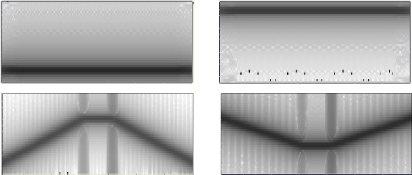
Experimental Design
Delayed-Match-to-Sample (DMS) Task
Tonal Contour Trial
Examples of Tonal Contours
(A)
Baseline
S1
Delay
S2
Response
To next trial
500
350
1000
350
1500
msec
(B)
Frequency
Frequency
Time
Time
Figure 5: (A) Delayed-match-to-sample task timeline (B Tonal contours (frequency vs. time)
Notes:
The experimental paradigm was a delayed-match-to-sample task, or DMS task. One trial consists of two stimuli presented with a delay between them. The total time for a trial is 350 milliseconds. For our experiments, the stimuli were either tones (sound at one frequency) or tonal contours (which consist of an upward and downward sweep, and vice versa). [Point to Tonal Contours] Subjects respond whether the two tones are the same (a match) or not (a non-match).
DMS tasks are used because they can be run on a variety of subjects (animals, humans) and do not require extensive training. No language is necessary for the task. Thus, data is readily available from animal physiological studies to compare to, and it is thus easier to adjust appropriate model parameters.

Slide 6
Regions of the Auditory Model
Ai
Aii
PFC
STG/STS
MGN
Figure 2: Regions of the auditory model and corresponding locations in the brain.
(Husain et al., Neuroimage, 21: 1701-1720, 2004)
Notes:
The auditory model is based on many brain regions.
MGN – medial geniculate nucleus
Ai and Aii act as the primary and secondary auditory cortices
STG – superior temporal gyrus
STS – superior temporal sulcus
PFC – prefrontal cortex

Slide 7
Network Diagram of Auditory Model
Aii
Up Selective Units
Ai
PFC
FS
Up Selective Units
Contour Selective Units
MGN
ST
D1
R
Down Selective Units
D2
Down Selective Units
Attention
Excitatory E → E
Inhibitory E → I
FS = cue selective
D1 = delay selective
D2 = delay+cue selective
R = response selective
Figure 3: Network Diagram of Auditory Model
Notes:
This is a network diagram of the auditory model I helped work on this past summer. Let me just walk you through the different aspects of the model.
The general idea for our model is that neurons in different areas have different response properties, so they respond to different kinds of stimuli at different frequencies.
1) The MGN serves as the input module, 81 basic units each sensitive to a particular range of frequencies
2) Ai and Aii roughly correspond to the primary and secondary auditory cortices. Ai responds to character frequency (CF), e.g. upward-sweep selective and downward-sweep selective. Different units inhibit signals for the other, and vice versa. Aii is similar to Ai, but are selective for longer sweeps.
3) For short-term auditory information retention, signal are passed through the STG.
4) PFC – prefrontal cortex (for short-term working memory tasks). During the delay between the stimuli, neurons stay active in the PFC (mainly D1 and D2)
It is important to note that for our model, there is both a specific portion and an analogous nonspecific portion. Nonspecific neurons correspond to those which are not directly involved with the auditory process at hand. There are cross-weights that connect between analagous regions of the two portions. This is essentially our method of introducing noise into the system.

Slide 8
Basic Units of Auditory Model
Basic Unit (cortical column)
Each module contains 81 basic units
Sigmoidal Activation Rule
60%
E
10%
15%
15%
I
Figure 4: Basic Wilson-Cowan unit.
Δ = rate of increase
δ = rate of decay
τ = input thresholds
N(t) = low-level noise
Notes:
Now I will give a brief overview of the basic units of our model.
A basic unit (or a Wilson-Cowan unit) represents a simplified cortical column or group of neurons (in our case we use 81 neurons per region, e.g. Ai upward-selective units), with excitatory corresponding to pyramidal neuronal populations and inhibitory corresponding to inhibitory interneurons. Excitatory contribute more overall due to larger synaptic weights. [Point to unit]
Parameters were chosen so that excitatory elements simulated neuronal activities in electrophysiological recordings (from monkeys).
Each unit is activated following the sigmoidal activation rule. Excitatory neurons and inhibitory neurons are activated based on parameters such as rate of increase, decay, input thresholds, and noise levels.

Slide 9
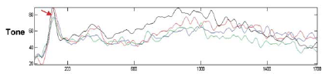
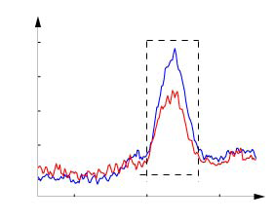
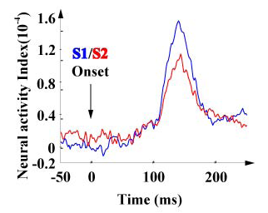


Prior Experimental Work: MEG Studies
(A)
(Luo et al., 2005. Fig. 2b)
(B)
(Feng et al., submitted for publication. Fig. 5b)
Figure 6: (A) MEG data from electrophysiological studies (B) MEG data from successive trials overlayed
Notes:
Now I will talk about past MEG studies, which are what I based the model on. We obtained data, and had to fit parameters to the data.
In physiological studies, researchers have seen a large response to MEG after sound presentation. What’s odd is the response after the second sound. The N1/M100 component can be seen in event-related signals with the peak at around 100 ms after stimulus presentation. These signals are localized to the Ai, Aii area (primary secondary auditory cortices). It has been found that the response to the second stimuli was shown to be suppressed when compared to the first stimuli’s response. [Point to top graph] It’s important to note the response between stimuli, when the subject is holding a previous stimulus in his mind.
At the bottom is a representative trial. A DMS (delayed-match-to-sample) task was run. What you’re looking at are the signals from the two stimuli overlayed on top of each other (S1 is blue and S2 is red). You’ll notice here that the M100 after the second stimuli is lower than after the first one.

Slide 10
Modified Auditory Model
Aii
Up Selective Units
Ai
PFC
FS
Up Selective Units
Contour Selective Units
MGN
ST
D1
R
Down Selective Units
D2
Down Selective Units
Attention
Excitatory E → E
Inhibitory E → I Inhibitory E → nsI
FS = cue selective
D1 = delay selective
D2 = delay+cue selective
R = response selective
Figure 7: Modified network diagram of auditory model
Notes:
My work this summer focused on modifying the model to simulate MEG data. We had already shown that the model works fairly well for fMRI data for many regions of the brain.
For the model, there are two main portions – specific and nonspecific. The nonspecific neurons are another group of neurons not directly involved in the task. They essentially act as a noise in the system.
[Click x 2]
Here, we have added four feedback inhibitory connections originating from D2 in the PFC. The connections go to inhibitory neurons in Ai and Aii (both specific and nonspecific). Note that “inhibitory” connections here originate from excitatory neurons.

Slide 11
Simulating MEG – Assumptions
Current dipole representing a region of the model can change strength but not direction.
(to excitatory neuronal elements)
MEG signal at source ~ local field potential
Notes:
In order to simulate MEG data, we made several assumptions. First, the current dipole representing a region of the model can change strength but not direction. MEG data is simulated using the local field potential, which is the difference between the currents of excitatory and inhibitory neurons due to excitatory elements. The MEG signal at the source is local field potential.

Slide 12
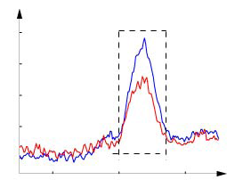
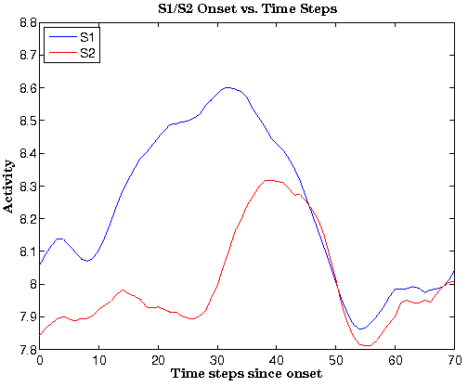
Results
Experimental Data
Simulation
(A)
Activity
(B)
Time
(Feng et al., submitted for publication. Fig. 5b)
(C)
S1: Onset of first stimulus
S2: Onset of second stimulus
Figure 8: (A) Experimental data from a DMS task with successive trials overlayed (B) Simulated MEG data with successive trials overlayed (C) Modulation index equation
Notes:
On the left is experimental data, and on the right is the output from the model for a tonal contour several tonal contour match trials (where blue represents the N1/M100 from the first stimulus and red from the second stimulus). As you can see, in the simulation, the second stimulus has been attenuated. [Explain axes, left is one trial, right is many]
As a way to measure the attenuation, a modulation index was used.
The modulation index is a normalization method for comparing two M100 curves. You take the difference between the first and second peak and divide it by the baseline activity level. Thus, a large MI value means there is a large difference between the two peaks (and that the second signal is significantly suppressed).

Slide 13
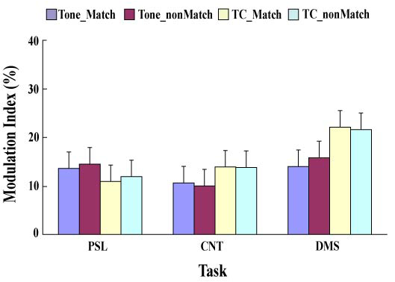
Results
Model
Figure 9: Modulation indices from simulated data with varying anatomical weights of excitatory to inhibitory connections from the PFC to the auditory cortex
Experimental
(Feng et al., submitted for publication. Fig. 5c)
Figure 10: Modulation indices from experimental MEG data
Notes:
To quantify the difference for systematically, I calculated modulation indices for different trial types for a variety of cross-weights.
So, as the weights increase, the modulation index increases. This occurs because as there is more PFC activity, there will be more suppression (due to inhibitory connections). Also, the difference between pure tones and tonal contours indicate that the attention level will be higher for more difficult stimuli (e.g. tonal contours) and thus contribute to more feedback (as indicated in the modulation indices).
Note: a negative modulation index means that the second stimulus was higher than the first stimulus.
[Click]
Here are the modulation indices from physiological studies, more specifically for DMS studies (on the right). The other parts of the graph are for other experiments.

Slide 14
Summary
We found model parameters that enable simulated and experimental MEG data to show similar behaviors.
Modulation indices demonstrate enhanced suppression of Ai and Aii during DMS task.
Notes:
In conclusion, we found model parameters which enabled our model to produce simulated MEG data exhibiting similar behaviors to experimental MEG data.
Furthermore, the modulation indices demonstrated enhanced suppression of Ai and Aii during DMS tasks and confirmed our hypothesis.

Slide 15
Future Work
In addition to modeling auditory processing pathways and simulating MEG data, the model also models fMRI data well.
Future work will focus on comparing the model against experimental data in which PFC activity is varied (by changing stimulation, complexity, etc.).

Slide 16
References
Husain, F.T., M.-A. Tagamets, S.J. Fromm, A.R. Braun, and B. Horwitz. "Relating neuronal dynamics for auditory object processing to neuroimaging activity: a computational modeling and an fMRI study." NeuroImage 21.4 (2004): 1701-720.
Rong, F., T. Holroyd, F.T. Husain, J.L. Contreras-Vidal, and B. Horwitz. "Task-Specific Modulation of Human Auditory Evoked Responses: An MEG Study." Submitted for print.
Tagamets, M.-A., and Barry Horwitz. "Integrating Electrophysiological and Anatomical Experimental Data to Create a Large-scale Model that Simulates a Delayed Match-to-sample Human Brain Imaging Study." Cerebral Cortex 8.4 (1998): 310-20.

Slide 17
Acknowledgements
Mentor: Ajay Pillai, PhD, NIDCD
PI: Barry Horwitz, PhD, NIDCD
Everyone in the Horwitz Lab (past and present)
Everyone involved with the NIH-BESIP Program

